Slide 1
Input and Output Devices
FA22-BCS-057

Slide 2
Input Devices
A piece of equipment/hardware which helps us enter data into a computer is called an input device.

Slide 3
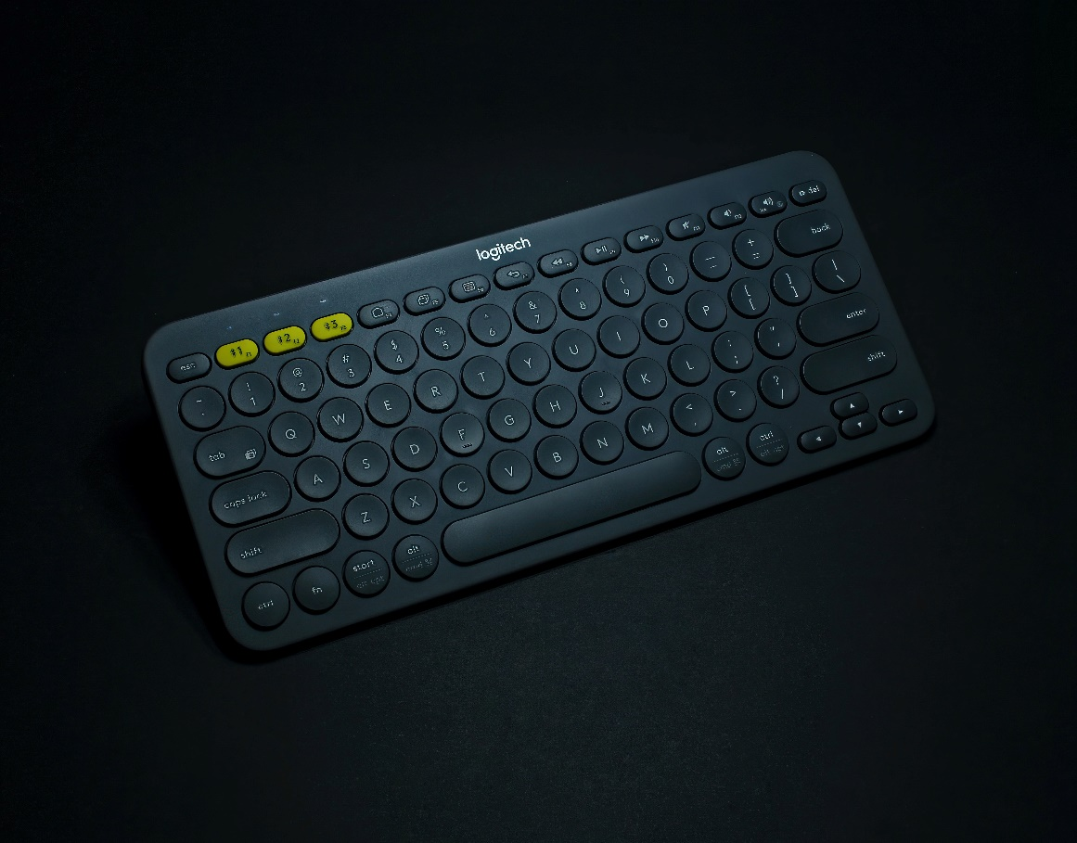
Keyboard
A simple device comprising keys and each key denotes either an alphabet, number or number commands which can be given to a computer for various actions to be performed
It has a modified version of typewriter keys
The keyboard is an essential input device and computer and laptops both use keyboards to give commands to the computer

Slide 4
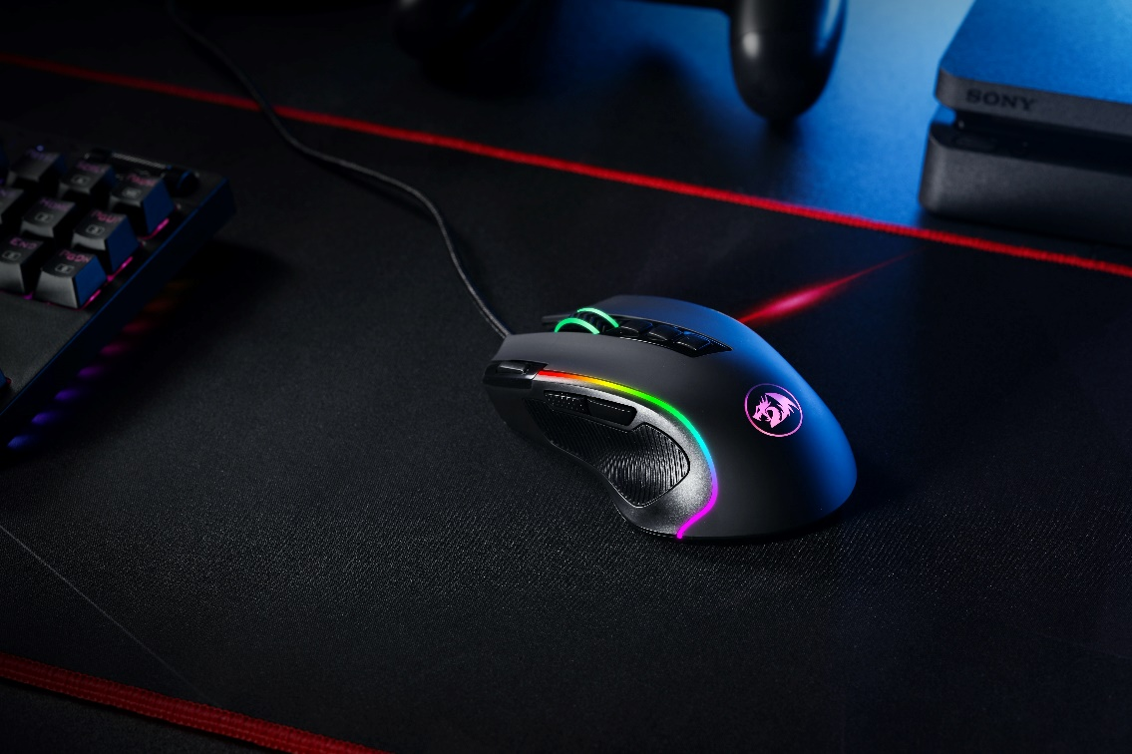
Mouse
It is also known as a pointing device
Using mouse we can directly click on the various icons present on the system and open up various files and programs
A mouse comprises 3 buttons on the top and one trackball at the bottom which helps in selecting and moving the mouse around, respectively
In case of laptops, the touchpad is given as a replacement of the mouse which helps in the movement of the mouse pointer.

Slide 5
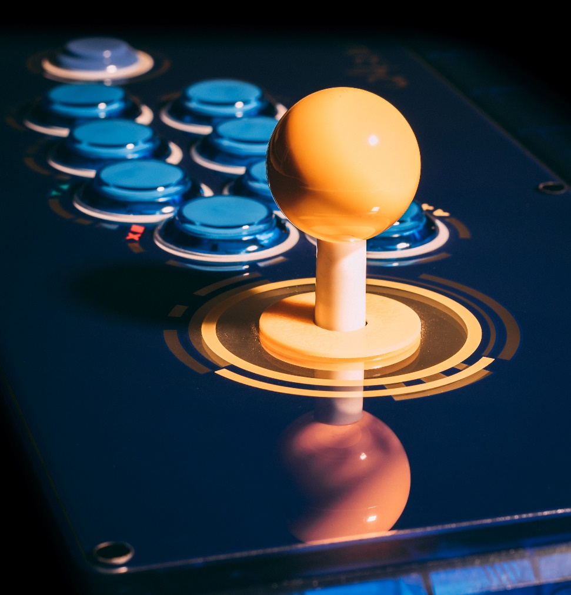
Joy Stick
It is a device which comprises a stick which is attached at an angle to the base so that it can be moved and controlled
Mostly used to control the movement in video games
Apart from a computer system, a joystick is also used in the cockpit of an aero plane, wheelchairs, cranes, trucks, etc. to operate them well.

Slide 6

Light Pen
It is a wand-like looking device which can directly be moved over the device’s screen
It is light-sensitive
Used in conjunction with computer’s cathode ray tube

Slide 7
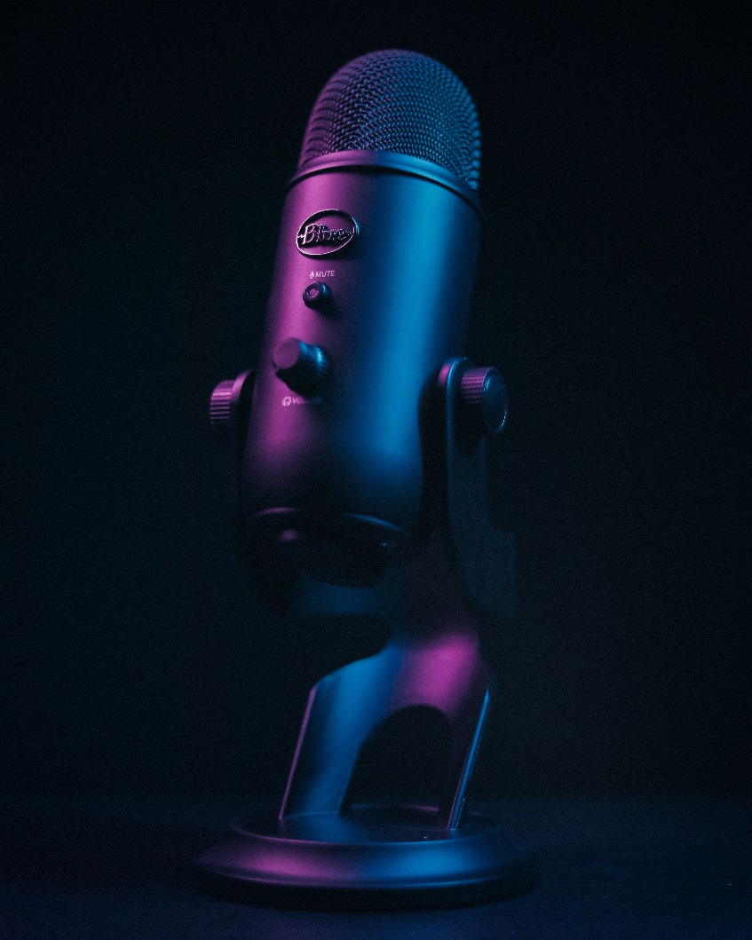
Microphone
Using a microphone, sound can be stored in a device in its digital form
It converts sound into an electrical signal
To record or reproduce a sound created using a microphone, it needs to be connected with an amplifier

Slide 8
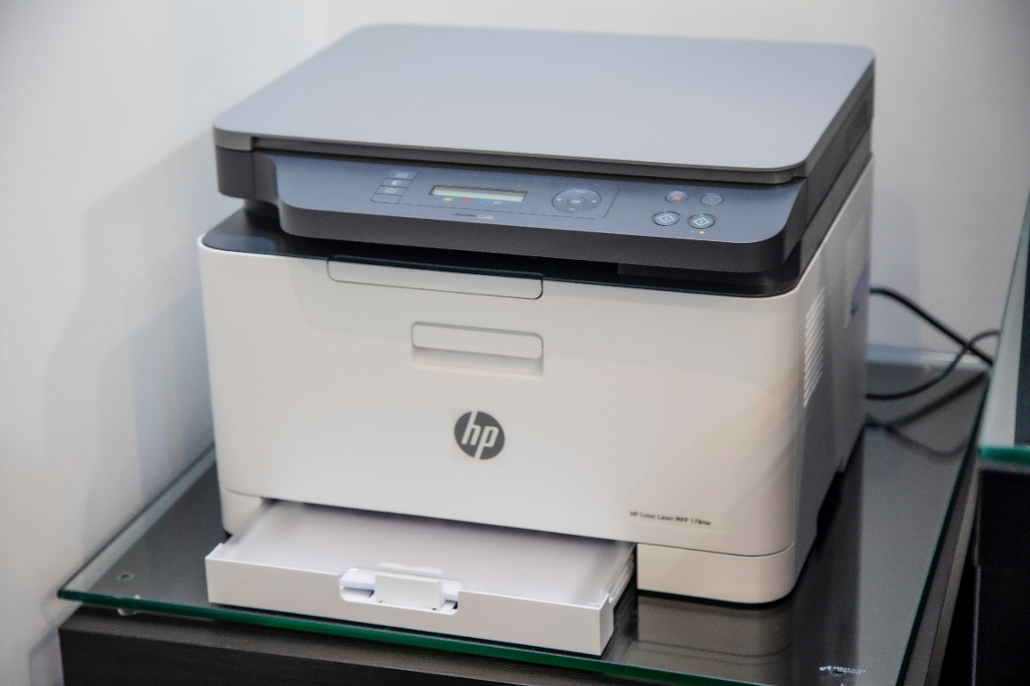
Scanner
This device can scan images or text and convert it into a digital signal
When we place any piece of a document on a scanner, it converts it into a digital signal and displays it on the computer screen

Slide 9
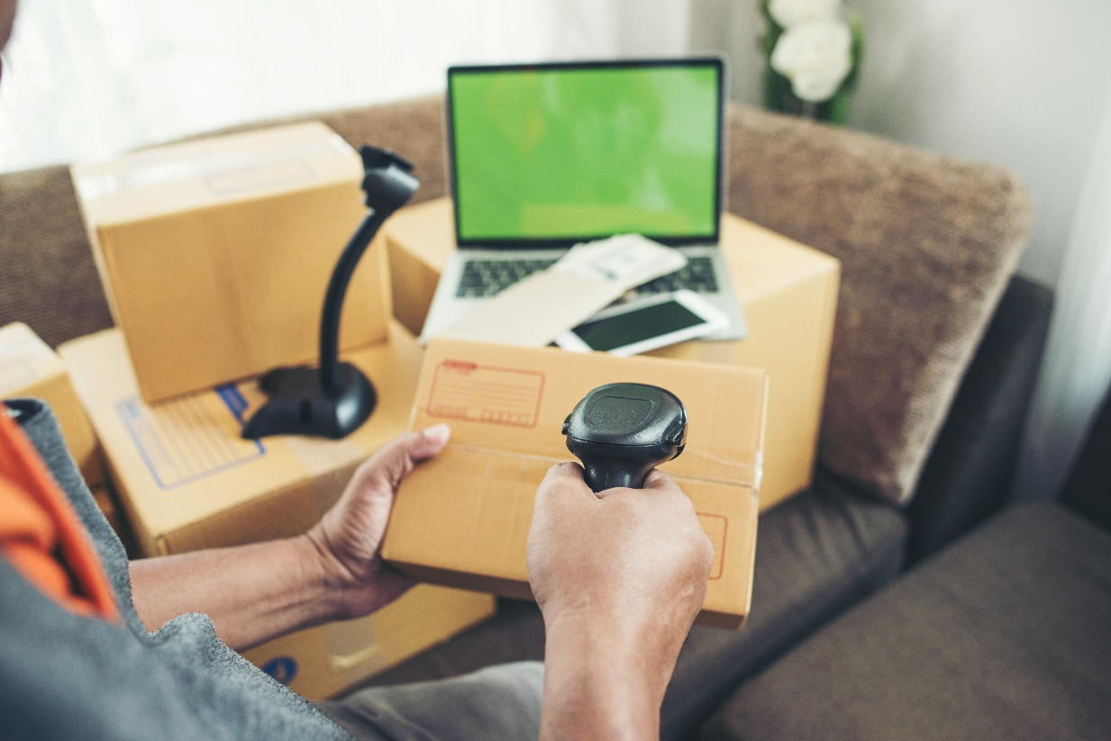
Bar Code Reader
It is a kind of an optical scanner
It can read bar codes
A source of light is passed through a bar code, and its aspects and details are displayed on the screen

Slide 10
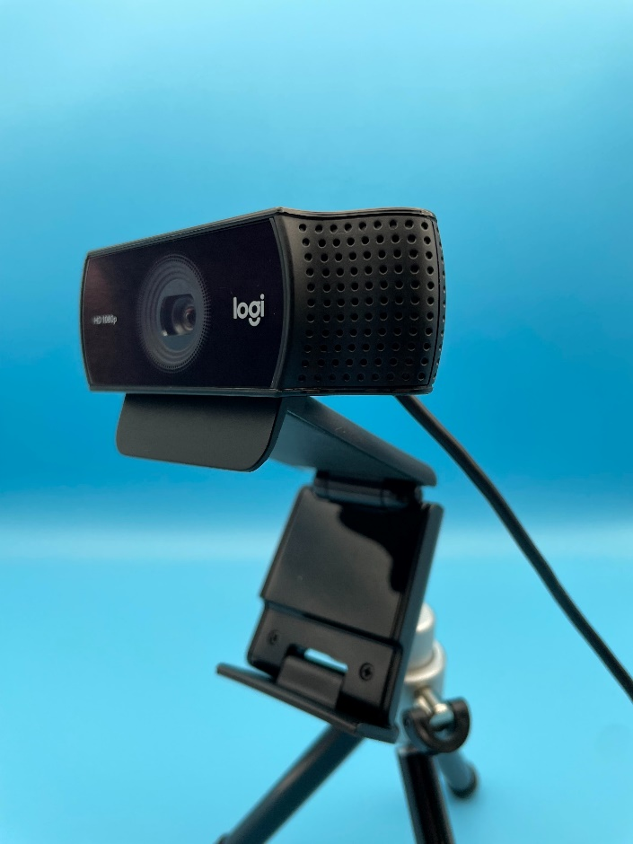
Webcam
A webcam is an input device that captures digital images.
These are transferred to the computer, which moves them to a server. From there, they can be transmitted to the hosting page.
Laptops and desktops are often equipped with a webcam.

Slide 11
Output Devices
A piece of equipment/hardware which gives out the result of the entered input, once it is processed (i.e. converts data from machine language to a human-understandable language), is called an output device.

Slide 12
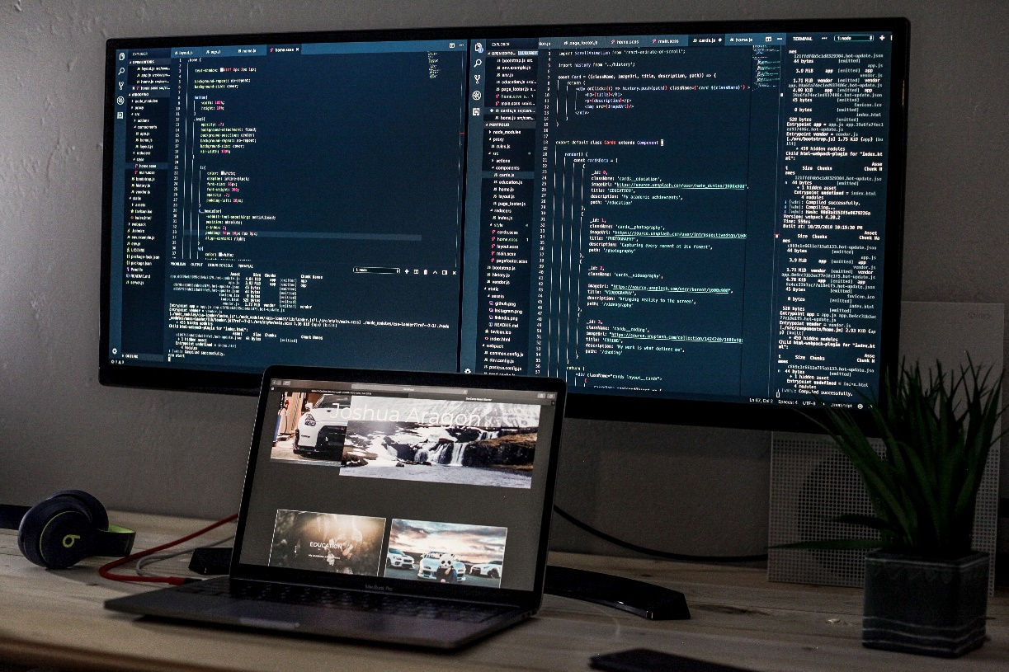
Monitor
The device which displays all the icons, text, images, etc. over a screen is called the Monitor
When we ask the computer to perform an action, the result of that action is displayed on the monitor
Various types of monitors have also been developed over the years

Slide 13
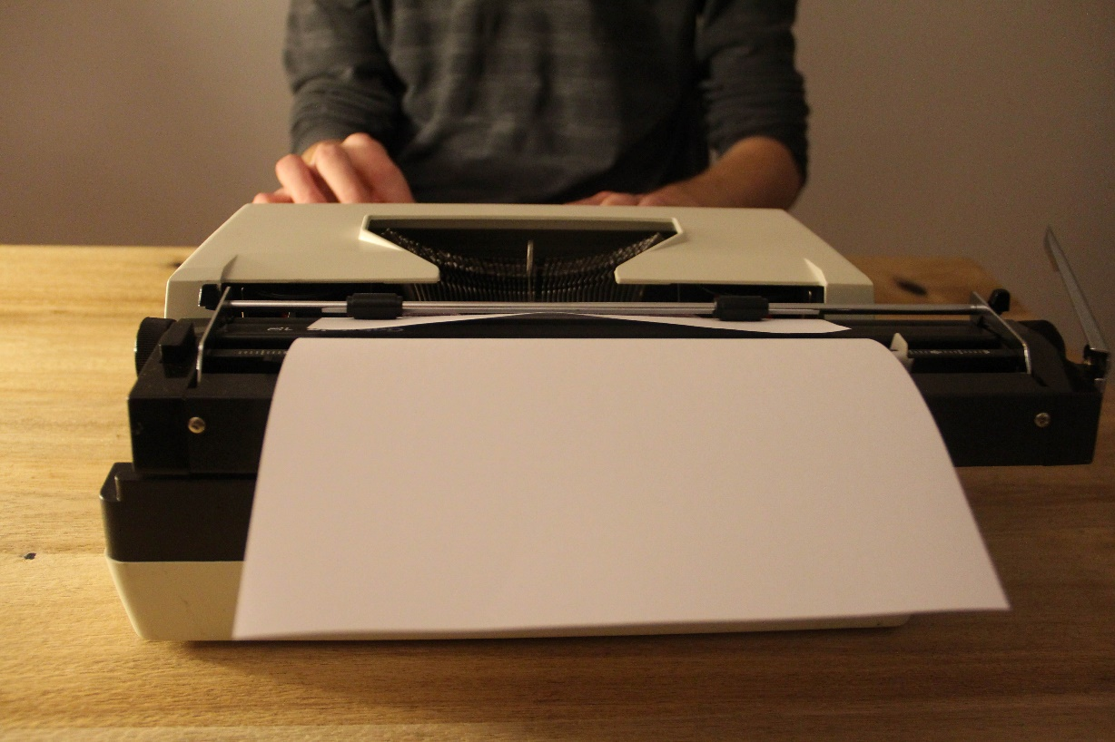
Printer
A device which makes a copy of the pictorial or textual content, usually over a paper is called a printer
For example, an author types the entire book on his/her computer and later gets a print out of it, which is in the form of paper and is later published
Multiple types of printers are also available in the market, which can serve different purposes

Slide 14
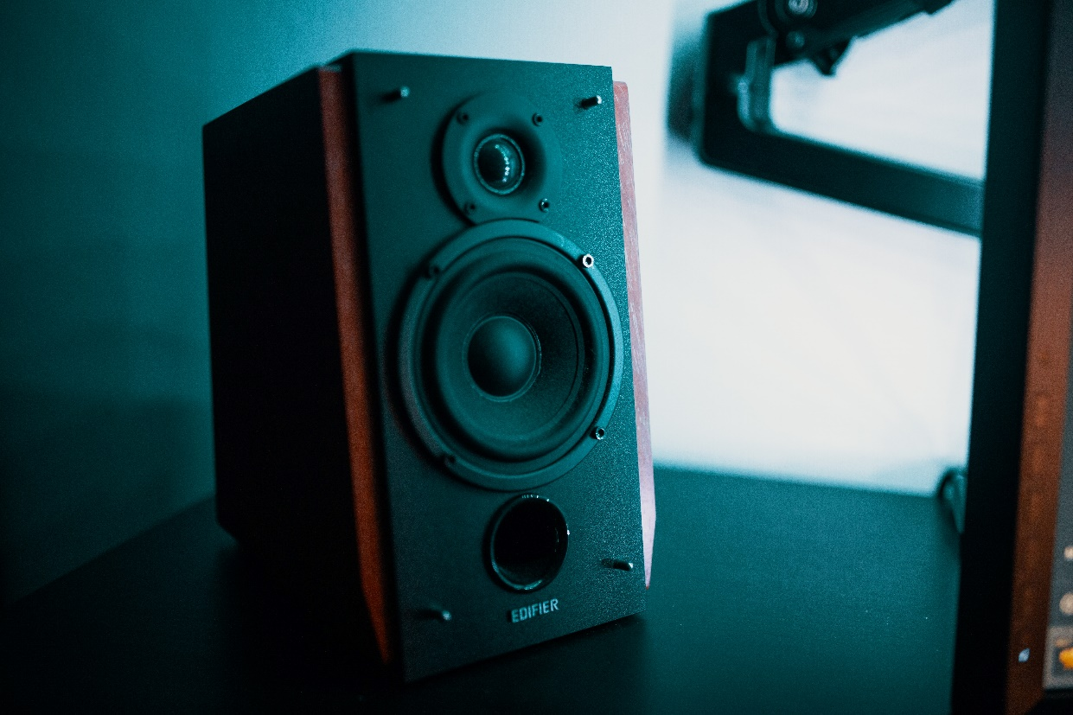
Speakers
A device through which we can listen to a sound as an outcome of what we command a computer to do is called a speaker
Speakers are attached with a computer system and also are a hardware device which can be attached separately
With the advancement in technology, speakers are now available which are wireless and can be connected using Bluetooth or other applications.

Slide 15
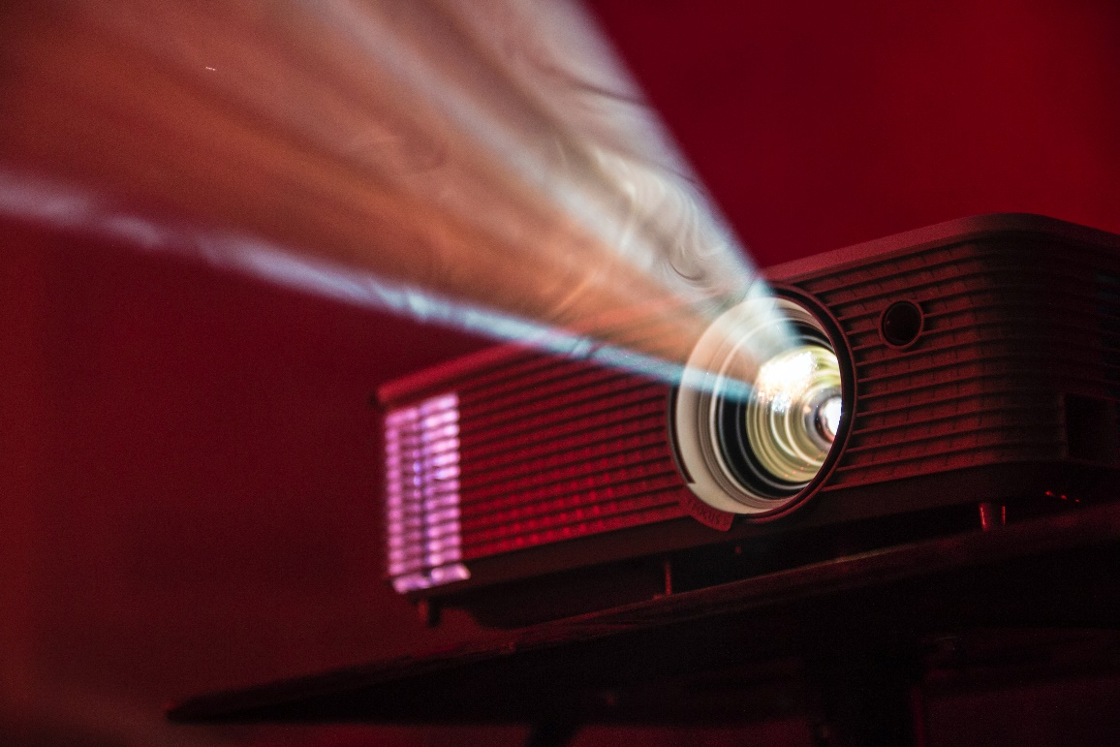
Projector
An optical device which presents an image or moving images onto a projection screen is called a projector
Most commonly these projectors are used in auditoriums and movie theatres for the display of the videos or lighting
If a projector is connected to a computer, then the image/video displayed on the screen is the same as the one displayed on the computer screen

Slide 16
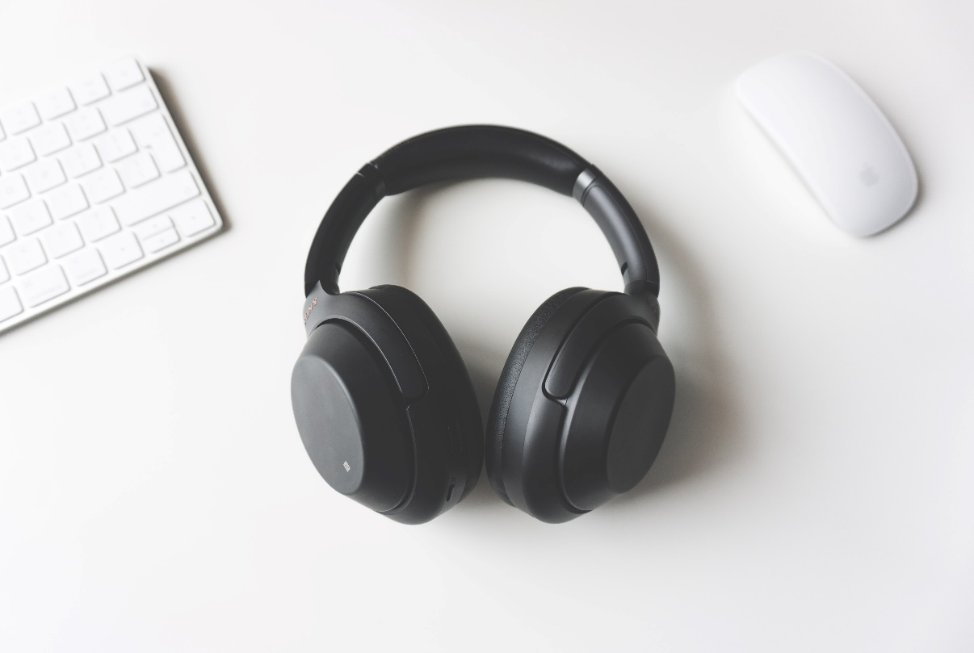
Headphones
They perform the same function as a speaker, the only difference is the frequency of sound
Using speakers, the sound can be heard over a larger area and using headphones, the sound is only audible to the person using them
Also known as earphones or headset

Slide 17
Thank You Very Much

